Slide 1
Title Slide
(opening music)
New Hire Benefits Summary
updated
Benefits 2019
Benefit Manager Lizette Agostini
Will advance automatically

Slide 2
Benefits
We all have different needs that influence the choices we make every day.
Through our Benefits Program, you have access to:
Health benefits that offer varying levels of coverage and accessibility
Company-paid benefits that protect you and your family from financial hardship, and
Voluntary benefits to provide you with added security.
To elect all your benefits log in to T4 and find the task in your Inbox. For 401k enrollments go to the Fidelity website.
You have access to
Health benefits
Company paid benefits
Voluntary benefits

Slide 3
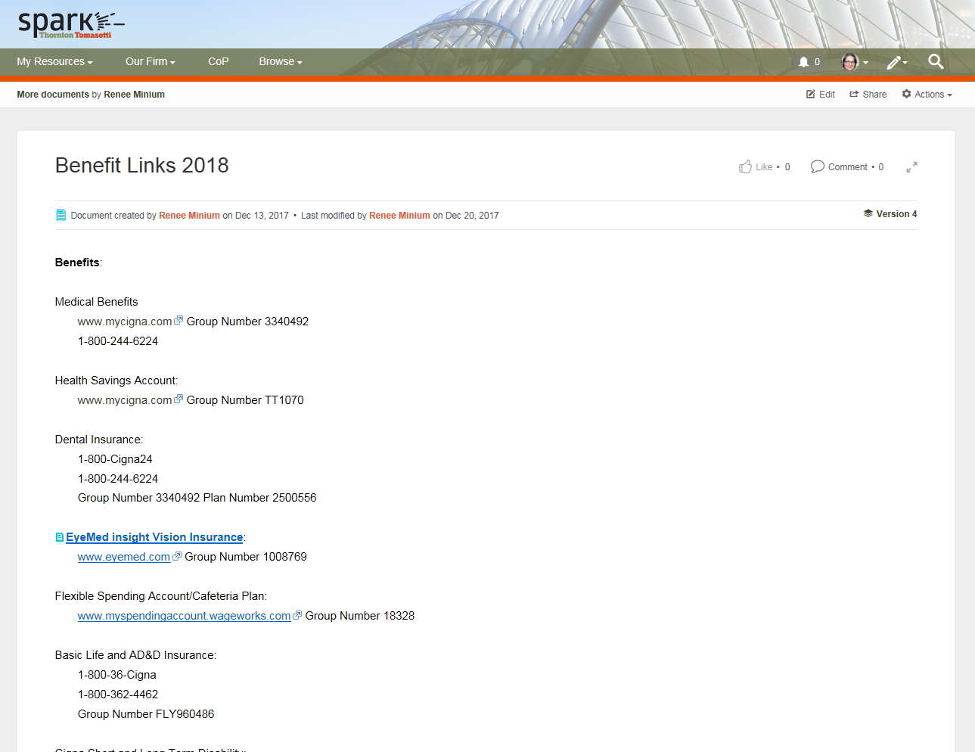
1-3
Benefits
During this training you will see buttons similar to the Note and Details buttons here. You will need to click the button to see additional information. Detail buttons open a document on Spark or a website. Clicking them is optional. All the other buttons must be clicked before you can move on.
updated
Note
Sent email to Margaret
Text updated
Details
https://spark.thorntontomasetti.com/docs/DOC-11482
Note
You may want to write down your choices as you go along.
Need Link

Slide 4
At Thornton Tomasetti, we offer a lot of benefits and we want you to take advantage of them. Since there is a lot of information to cover we developed a learning activity to make it more interactive.

Slide 5
1-5
Opening
This is the Strange Door Building. You are the field engineer.
You must complete a site visit to the Strange Door Building. Open all the doors in order to learn about your TT benefits. All rooms will have information about benefits, some rooms will have hidden questions and each floor will have level up questions.
Your goal is to answer all the questions correctly to earn points. First you must locate the questions. To locate hidden questions, click different areas of the screen. Remember only some have questions. For each correct answer you earn a point. For incorrect answers you lose a point.
If you prefer to read the information rather than participate in the learning activity, click the red exit door to read the brochure. Click NEXT to start the activity.
Exit
Exit door link
https://spark.thorntontomasetti.com/community/departments/talent-team/associates/blog/2018/11/15/2019-benefits-summary
Arrow pointing to red exit door
Choose floor slide

Slide 6
1-6
Choose your avatar
Choose a key to open the doors. You will use the key as your player piece.
Alternate avatars:

Slide 7
3-1
Floor 1
To complete this level use your key to open all the doors. Drag the key to the door you want to open. When all doors are opened you will see a level up question.
The doors will have a “visited” state to indicate they have been opened.
When all the doors are visited the “click NEXT to continue” message will appear
Similar slides will be created for each floor.

Slide 8
Level Up Question Level 1
True or False?
Cigna dental insurance is fully paid for by the employee.
?
?
?
?
?
?
?
They can retake the question until they get it correct.
Feedback
TT provides employees with a comprehensive dental plan through Cigna at no cost to the employee. Cigna provides varying levels of coverage and accessibility.
Back to Floor choices

Slide 9
Level Up Question Level 2
If you need additional protection beyond the Basic Life Insurance provided, you may purchase additional life Insurance for yourself and your eligible dependents. If you elect this coverage, you will be responsible for paying 100% of the benefit cost and will have deductions taken from your paycheck in
Pre-tax dollars
After-tax dollars
?
?
?
?
?
?
?
They can retake the question until they get it correct.
Feedback
If you need additional protection beyond the Basic Life Insurance provided, you may purchase additional life Insurance for yourself and your eligible dependents. If you elect this coverage, you will be responsible for paying 100% of the benefit cost and will have deductions taken from your paycheck in after-tax dollars.
Back to Floor choices

Slide 10
Level Up Question Level 3
Fill in the blank.
The traditional 401(k) plan is a retirement savings plan which allows you to save and invest a portion of your earnings on a ____ basis.
Pre-tax
After-tax
?
?
?
?
?
updated
?
?
They can retake the question until they get it correct.
Feedback
The traditional 401(k) plan is a retirement savings plan which allows you to save and invest a portion of your earnings on a pre-tax basis.
Back to Floor choices

Slide 11
Floor 1
7 doors

Slide 12
3-2
Eligibility for Benefits
Regular employees working 30 or more hours per week are eligible to participate in the Thornton Tomasetti Benefits Program on your first day of employment.
If you are eligible for and enroll in individual coverage, you may elect to cover your spouse/domestic partner and your children up to age 26. Dependent children will be covered up until the end of the month in which they turn 26.
Correct – no change
Regular employees working 30 or more hours per week are eligible to participate in benefits.
No link needed
Back to level 1 doors

Slide 13
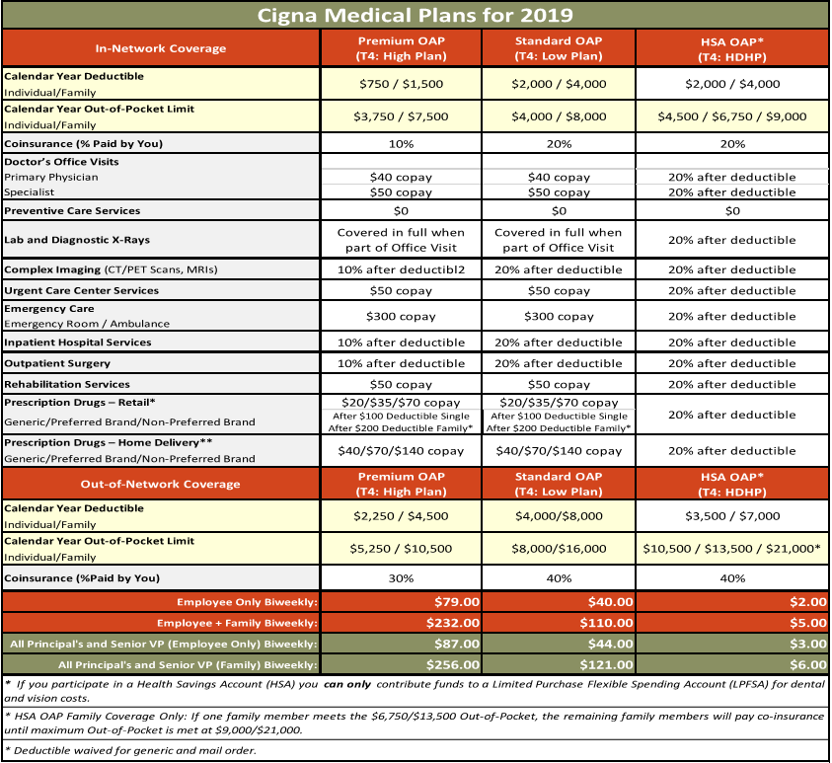
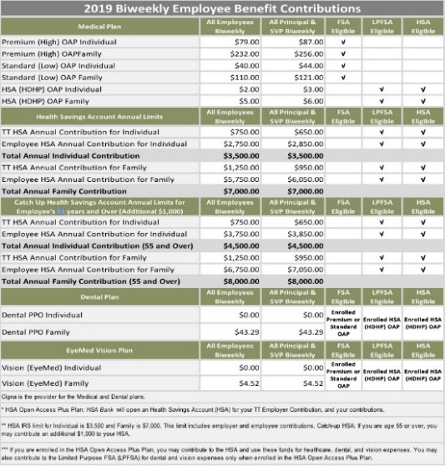
3-3
Health Care Benefits
Coverage, choice, cost and convenience are factors you should consider before selecting a medical plan. You may choose from three medical plans provided through Cigna, or you may choose to waive medical coverage. All of your medical plan options are designed to provide you and your family with access to quality, affordable health care. The plans differ in how they share costs with you when you receive care and how much you pay for coverage each pay period. Click the chart button to understand the differences. Click the Details button to get all the links for the detailed plan documentation.
Coverage, choice, cost and convenience:
Premium Open Access Plus Plan.
Standard Open Access Plus Plan.
Health Savings Account (HSA) Plan.
For you and your family.
Differ in how they:
Share costs.
When you receive care.
How much you pay.
Cost
Chart
Details
Updated, changed buttons
Links
High
https://spark.thorntontomasetti.com/docs/DOC-11191
https://spark.thorntontomasetti.com/docs/DOC-11180
Low
https://spark.thorntontomasetti.com/docs/DOC-11178
https://spark.thorntontomasetti.com/docs/DOC-11175
HSA
https://spark.thorntontomasetti.com/docs/DOC-11177
https://spark.thorntontomasetti.com/docs/DOC-11176
Chart layer
Back to level 1 doors

Slide 14
3-4
Health Spending Account (HSA)
If you enroll in the HSA High Deductible medical plan offered by Thornton Tomasetti, you may elect to contribute funds to an HSA on a pre-tax basis. You may use your HSA funds to pay for medical expenses that are not covered by the medical plan.
The HSA plan offers you the option to invest your money for potential long-term savings and tax advantages when you do not spend it on current eligible health expenses. It’s an easy way to start – or add to – your investment portfolio.
Thornton Tomasetti will contribute $750 for single or $1,250 for family coverage for employees and $650 for single or $950 for family for SVPs and Principals.
Cost
You may elect to contribute funds to an HSA on a pre-tax basis.
Employees SVPs and Principals
$750 Single $650 Single
$1250 Family $950 Family
Note
Updated
Details
Details
https://spark.thorntontomasetti.com/docs/DOC-10934
Cost
Display chart
Note
If you enroll in the HSA High Deductible medical plan and contribute funds to an HSA, you cannot enroll in the Health Care FSA. You may participate in one or the other, but not both. You do have the option of participating in the Limited Purpose FSA (LPFSA), which can be used only for dental and vision expenses. If you enroll in the Standard Open Access Plus or Premium Open Access Plus medical plan, you cannot make contributions to an HSA account.
Has a hidden bonus question
Return to level 1 doors

Slide 15
Updated
4
Bonus Question
True or False?
You can enroll in both the HSA and the healthcare FSA.
?
?
?
?
?
?
?
They can retake the question until they get it correct.
Feedback
If you enroll in the HSA High Deductible medical plan and contribute funds to an HSA, you cannot enroll in the Health Care FSA. You may participate in one or the other, but not both. You do have the option of participating in the Limited Purpose FSA (LPFSA), which can be used only for dental and vision expenses. If you enroll in the Standard Open Access Plus or Premium Open Access Plus medical plan, you cannot make contributions to an HSA account.

Slide 16
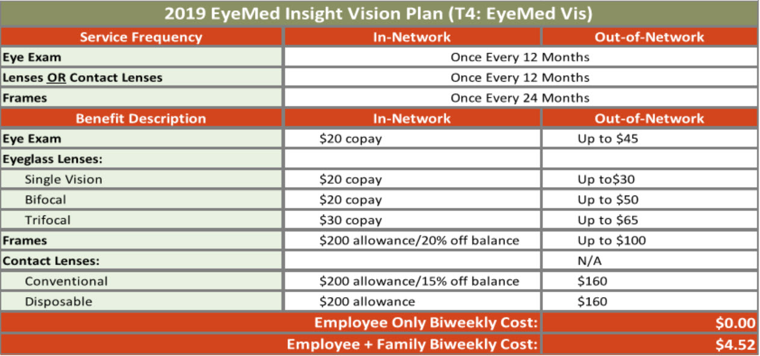
3-5
Vision Insurance
A voluntary vision benefit, provided through EyeMed Insight, can be elected to cover yourself and your eligible dependents. This plan provides benefits for an eye exam, glasses (lenses and frames), or contact lenses.
updated
Cost
Details
Comprehensive plan from EyeMed
https://spark.thorntontomasetti.com/docs/DOC-11195
Cost Button Layer
Display chart
Has a hidden bonus question
Back to level 1 doors

Slide 17
5
Bonus Question
True or False?
Family coverage is not available for EyeMed.
?
?
?
?
?
?
?
They can retake the question until they get it correct.
Feedback
False. A vision benefit, provided through EyeMed, can be elected to cover yourself and your eligible dependents.

Slide 18
3-6
Dental Insurance
Good dental health is important to your overall well-being. It is for this reason that Thornton Tomasetti provides employees with a comprehensive dental plan through Cigna, which provides varying levels of coverage and accessibility.
updated
Cost
Comprehensive plan from Cigna
Details
Details
https://spark.thorntontomasetti.com/docs/DOC-11193
Cost Button Layer
Display chart
Back to level 1 doors

Slide 19
3-7
Flexible Spending Accounts (FSA)
You can direct a portion of your pay through pre-tax payroll deductions to FSAs. There are three types of plans available to you.
Healthcare tab
You can elect up to $2,650 of your salary into the FSA Health Care account. You can use this account to pay eligible expenses not covered by your medical plan with pre-tax funds, such as deductibles, copays, coinsurance, orthodontia, vision care expenses, and hearing care expenses. You cannot use this FSA if you have chosen the HSA health plan.
Dependent tab
You can elect up to $5,000 of your salary per plan year into a Dependent Care FSA ($2,500 if you are married and you and your spouse file individual income tax returns). Eligible expenses include, but are not limited to, payments to day care centers, preschool costs (up to, but not including, kindergarten), after school care, and elder care.
Limited Purpose FSA
A limited purpose FSA is a healthcare spending account that can only be used for eligible vision and dental expenses. Unlike a healthcare FSA, however, an LPFSA can be held at the same time as a Health Savings Account (HSA)
Note
LPFSA
updated
Healthcare
Dependent
Details
FSA funds are deducted from your pay on a pre-tax basis.
Screen for Health care
Up to $2650 per year
Deductibles
Copays
Coinsurance
Orthodontia
Vision care
Hearing care
Screen for LPFSA
May be used for vision and dental expenses.
You may elect to have an LPFSA if you choose the HSA medical plan. You can contribute up to $2650 to an LPFSA
Details
https://spark.thorntontomasetti.com/docs/DOC-11225
Screen for Dependent
Up to $5000 per year
Day care
Preschool
After school
Elder care
($2,500 if you are married and you and your spouse file individual income tax returns).
Has a hidden bonus question
Back to level 1 doors
Screen for Note
If you enroll in the HSA High Deductible medical plan and contribute funds to an HSA, you cannot enroll in the Health Care FSA. You may participate in one or the other, but not both. You do have the option of participating in the Limited Purpose FSA (LPFSA), which can be used only for dental and vision expenses. If you enroll in the Standard OAP or Premium OAP medical plan, you cannot make contributions to an HSA account.

Slide 20
Updated
7
Bonus Question
The money that goes into an FSA is deducted from your pay on a ____
Pre-tax basis
Post-tax basis
?
?
?
?
?
?
?
They can retake the question until they get it correct.
Feedback
The money that goes into an FSA is deducted from your pay on a pre-tax basis.

Slide 21
Floor 2
5 doors

Slide 22
4-2
Basic Term Life and Accidental Death & Dismemberment (AD&D)
As an eligible employee, you are automatically provided with Basic Life and accidental death and dismemberment Insurance of $100,000 at no cost to you. (Benefits are subject to age reductions.)
updated
Note
Basic Life and AD&D is provided by TT at no cost to you. (Benefits may be subject to age reductions)
Details
Details
https://spark.thorntontomasetti.com/docs/DOC-11380
Costs
Coverage is guaranteed; there is no need to answer any medical questions
Benefit reduces to 65% @ age 70, then to 50% @ age 75
If you become disabled, the premium for your life insurance will be waived, but the coverage will remain
If you become terminally ill, you may be eligible to “cash out” your life insurance up to $80,000
The policy also includes accidental death and dismemberment benefits as well as some business travel benefits
100% of cost paid for by Thornton Tomasetti

Slide 23
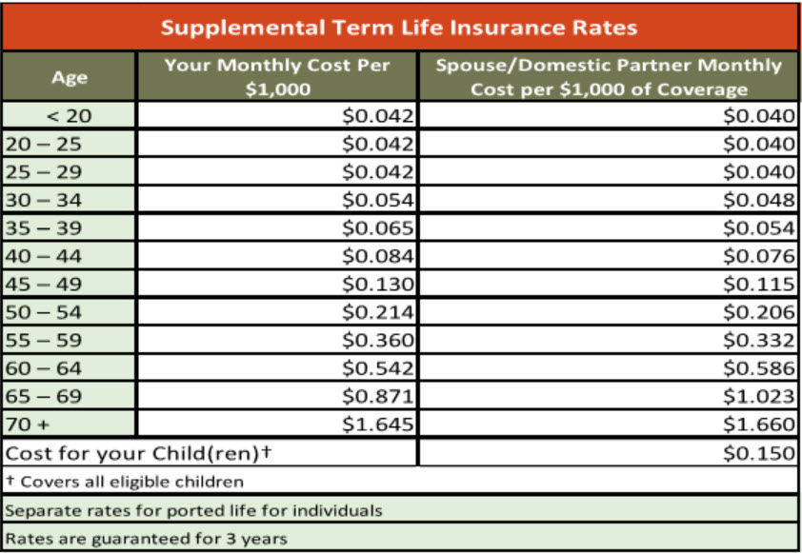
4-3
Employee Supplemental Life Insurance
If you need additional protection beyond the basic life insurance provided, you may purchase additional life insurance for yourself, spouse or domestic partner and your eligible dependents. If you elect this coverage, you will be responsible for paying 100% of the benefit cost and will have deductions taken from your paycheck in after-tax dollars.
updated
Note
If you elect this coverage, you will be responsible for paying 100% of the benefit cost and will have deductions taken from your paycheck in after-tax dollars.
Chart
Details
https://spark.thorntontomasetti.com/docs/DOC-10940
Note
Employee benefit:
Purchase units of $25,000 to a maximum of 3 times salary or $500,000
Evidence of Insurability (EOI) is required, however, there is a minimum guarantee of $25,000
Policy includes waiver of premium during certain circumstances of illness or disability; the option to “cash out” in the event of a terminal illness for the lesser of 80% or $400,000; and the option to take the policy with you if you leave the company.
Has a hidden bonus question
Go back to doors

Slide 24
9
Bonus Question
Fill in the blank:
You have the option to purchase spousal/domestic partner term life insurance coverage in units of $1,000 to the lesser of $250,000 or 100% of Employee’s Supplemental amount, whichever is ____.
Less
More
?
?
?
?
?
Delete question
?
?
They can retake the question until they get it correct.
Feedback
You have the option to purchase spousal/domestic partner term life insurance coverage in units of $1,000 to the lesser of $250,000 or 100% of Employee’s Supplemental amount with a Guarantee Issue amount of $25,000 without Evidence of Insurability. Any amount over the Guarantee Issue of $25,000 will be subject to Evidence of Insurability.

Slide 25
4-4
Spousal/Domestic Partner Life Insurance
You have the option to purchase spousal/domestic partner term life insurance coverage.
updated
Moved note to audio to address changes
Supplemental life coverage required.
Note
NOTE:
You have the option to purchase spousal/domestic partner term life insurance coverage in units of $1,000 to the lesser of $250,000 or 100% of Employee’s Supplemental amount with a Guarantee Issue amount of $25,000 without Evidence of Insurability. Any amount over the Guarantee Issue of $25,000 will be subject to Evidence of Insurability.

Slide 26
4-5
Child Life Insurance
You have the option to purchase child term life insurance coverage for your dependent children. The benefit is $1,000 for children from birth to 6 months and $4,000 from 6 months up to 26 years, if a full time student.
updated
$1,000 from birth to 6 months
$4,000 from 6 months to 26, if full time student
Supplemental life coverage required.
Note

Slide 27
4-6
Short and Long-Term Disability
Short Term and Long Term Disability are provided at no cost to you.
Short
Long
Updated, changed buttons
Note
Short Term and Long Term Disability are provided at no cost to you.
Short Term Disability (STD) insurance helps you replace a portion of your income during the initial weeks of a disability. If you are unable to work due to illness or injury and you miss more than a week of work, you may apply for STD benefits. The benefit amount is 66.67% of your average weekly earnings up to the plan’s maximum weekly benefit of $637.00 per week.
New Jersey and California have state-mandated disability insurance programs that they administer.
Long Term Disability (LTD) insurance provides a benefit of 60% of your pre-disability earnings up to a maximum of $25,000 per month(if your coverage request is approved), if you are unable to perform the duties of your job for more than 90 days due to your illness or injury. LTD benefits will continue to be payable subject to plan parameters and limitations.
LTD benefits are taxable when an employer pays the insurance premium on the policy, which means any approved benefits payable to you are considered taxable income. To change the taxable nature of your LTD benefit, you have the option to pay taxes on the LTD premium that is paid on your behalf by TT, which means if you are approved for benefits, there would be no taxes payable on the LTD benefits you receive. No matter what choice you make, TT will continue to pay the LTD premiums on your behalf.
PLEASE NOTE: The disability benefits provided by Thornton Tomasetti, Inc. will be reduced by any benefits you are eligible to receive from Social Security, Workers’ Compensation, Retirement Benefits, or any other disability coverage to which you are entitled.
Has a hidden bonus question
Go back to doors
Is there a link?

Slide 28
12
Bonus Question
Fill in the blank:
Long Term Disability (LTD) insurance covers you if you are unable to perform the duties of your job for more than ____days due to your illness or injury.
90 days
80 days
120 days
?
?
?
?
?
?
?
They can retake the question until they get it correct.
Feedback
Long Term Disability (LTD) insurance covers you if you are unable to perform the duties of your job for more than 90 days due to your illness or injury.

Slide 29
Floor 3
8 doors

Slide 30
5-2
401k
The 401(k) plan is a retirement savings plan which allows you to save and invest a portion of your earnings on a pre-tax basis. Contributions are automatically deducted from your paycheck each pay period and are invested at your direction into one or more funds provided in the plan.
Age 50 or Over?
Retirement savings plan.
Automatically deducted.
Invested at your direction.
You may elect to save up to 60% of your eligible compensation up to the annual IRS limit of $19,000. You can choose to save in either a traditional or Roth 401(k)
Roth 401(k)
Traditional 401(k)
Details
www.401k.com
https://spark.thorntontomasetti.com/docs/DOC-11893
Age 50
If you are age 50 or over by the end of the taxable year, you may make additional contributions up to the IRS catch-up limit of $6,000. There is a discretionary match of 50% on up to 7% of eligible compensation deferred into the plan. Matching contributions are subject to a 6-year step vesting schedule.
A Traditional 401(k) gives you a choice of investment options. Your contributions to a 401(k) plan and any earnings from the investments are tax-deferred.
A Roth 401(k) plan is similar to a traditional plan with one major exception. Your contributions are not tax-deferred but are made with after-tax dollars. Income earned on the account from interest, dividends and capital gains is tax-free.
Next

Slide 31
5-3
Global Health Benefits
Full-time employees traveling on business outside of the United States who experience an unexpected injury or illness are covered by our Cigna Medical Benefits Abroad business travel insurance policy. Employees enrolled in a Cigna medical plan with TT who travel abroad for vacation are covered for certain medical services.
updated
Details
Details
https://spark.thorntontomasetti.com/docs/DOC-10926
Next

Slide 32
5-4
Employee Assistance Program (EAP)
The EAP is provided through Cigna at no cost to you and offers confidential counseling and other tools and resources to help you and members of your immediate family deal with everyday life challenges.
Note
updated
Details
Offers confidential counseling and other tools and resources to help you 24 hours a day, seven days a week and 365 days a year.
https://spark.thorntontomasetti.com/docs/DOC-9783-employee-assistance-program-eappdf
Note
This program can provide assistance with relationship problems, elder care, work/career matters, parenting and child care, legal and financial issues and much more.
Through the EAP, you can take advantage of face-to-face sessions for short-term problem resolution. In addition, the EAP provides you with unlimited access to telephonic and online resources 24 hours a day, seven days a week, 365 days a year.
Next

Slide 33
14
Bonus Question
The EAP provides you with:
Unlimited access 24 hours a day, seven days a week, 365 days a year.
Access seven days a week from 9:00 A.M. to 9:00 P.M.
Unlimited access 24 hours a day, seven days a week except for holidays.
?
?
?
?
?
?
?
They can retake the question until they get it correct.
Feedback
The EAP provides you with unlimited access 24 hours a day, seven days a week, 365 days a year.

Slide 34
5-5
Commuter Spending Accounts
Transit and Parking
The commuter spending accounts allow you to save money for eligible transportation and parking expenses with pre-tax money on a monthly basis. The IRS limits the amount you may contribute to each spending account to $265 for 2019. Limits are determined each year by the IRS.
Commuter Transit
Qualified Parking
BRI
You may contribute up to $265 a month each on a pre-tax basis into a commuter transit plan and a qualified parking plan.
Details
Transit
Deduction timing still true?
Details
https://spark.thorntontomasetti.com/docs/DOC-11227
Commuter Transit
You may contribute up to $265 a month on a pre-tax basis into a commuter transit plan. You may also make post-tax contributions if your monthly commuting expense exceeds $265. The account is used to pay for eligible mass transit or vanpool expenses associated with travel to and from work, including ferry, bus, train or subway.
This deduction amount is withheld from the first paycheck of each month.
Qualified Parking
You may contribute up to $265 per month on a pre-tax basis into a qualified parking plan. The account is used to pay for eligible parking expenses either near your place of employment or at a location from which you commute to work via mass transit or vanpool.
This deduction amount is withheld from the second paycheck of each month.
Next
BRI (Benefits Resource Inc.) manages our FSA and Commuter Benefits as of January 1, 2019.
You can visit their website at www.Benefitresource.com information and tools to:
▪ Review your spending account balances
▪ Review claims status
▪ View your statements

Slide 35
16
Bonus Question
Is this accurate? Is it 265 each?
Fill in the blank.
You may have a Commuter Transit Plan and Qualified Parking plan and can contribute _____ per month each in pre-tax dollars.
$265
$290
$500
?
?
?
?
?
?
?
They can retake the question until they get it correct.
Feedback
You may contribute up to $265 a month each on a pre-tax basis into a commuter transit plan and a qualified parking plan.
Back to Floor choices

Slide 36
5-6
Tuition Reimbursement
The company will reimburse employees up to $6,000 for tuition, books and fees per calendar year. Courses must be approved prior to enrollment, and the reimbursement form must be signed by an office director.
Not in current guide. Any changes?
Up to $6000 per calendar year.
Courses must be approved prior to enrollment.
Reimbursement form must be signed by an office director.
https://spark.thorntontomasetti.com/docs/DOC-2440

Slide 37
5-7
Gym Reimbursement
The company reimburses up to $400 per year for employees only (not family members) for fitness club membership Fees. You are only eligible to be reimbursed once in a 12-month period.
Not in current guide. Any changes?
Expenses for fitness classes such as yoga, pilates, kickboxing etc. may also be included.
Details
Details
https://spark.thorntontomasetti.com/docs/DOC-2371

Slide 38
17
Bonus Question
Fill in the blank.
You are only eligible to be reimbursed ____in a 12-month period.
One time
Two times
Three times
?
?
?
?
?
?
?
They can retake the question until they get it correct.
Feedback
You are only eligible to be reimbursed once in a 12-month period.
Back to Floor choices

Slide 39
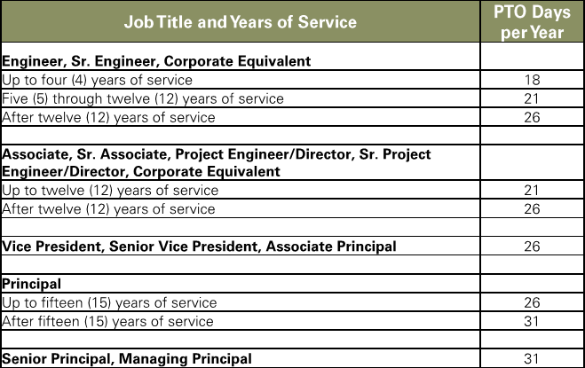
Paid Time Off
We know how hard you work and recognize the importance of providing time for rest and relaxation. We fully encourage employees to get this rest by taking paid time off. Time off under this policy includes vacation as well as sick and safe time for you or a family member.
PTO is available to continuing full time (FT) and part time (PT) employees scheduled to work twenty (20) or more hours per week.
Chart
Details
Chart
If eligible, you will accrue PTO for each month of service. The annual PTO accrual rate for continuing FT employees is based on job title and years of service as follows:
https://spark.thorntontomasetti.com/docs/DOC-11387

